Slide 1
New Members

Slide 2
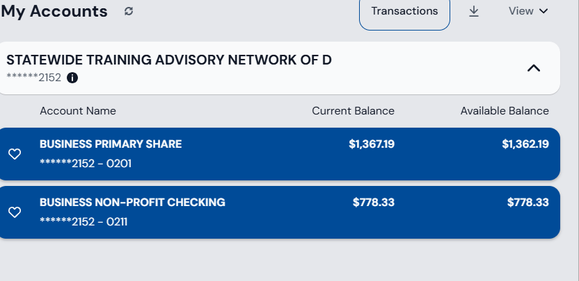
Treasures report

Slide 3
Ice Breaker
Give them 5 minutes to do this: Each person chooses one small concept they teach well—a rule, a skill, a definition, a process. Then they deliberately explain it badly to their partner. Not maliciously—just poorly. Too fast, too vague, too jargony, or wildly out of order.
After both have taken a turn, give them 3 minutes to discuss:
What made the explanation confusing?
What assumptions did the “teacher” accidentally make?
What one change instantly improved clarity?
Bring the group back together and ask for a few rapid reflections:
“What bad habit did you recognize in yourself?”
“What tiny fix made the biggest difference?”

Slide 4
Overcoming Common Trainer Challenges
STAND Networking Session
January 16 | GSS Building
Mathew Lemite

Slide 5
Introduction
Purpose of today’s session
Networking, collaboration, and practical problem-solving

Slide 6
Why Trainer Development Matters
Engaged trainers create engaged learners
Effective training strengthens systems

Slide 7
Planning Effective Training Sessions
Balancing
Balancing content and discussion
Designing
Designing with adult learners in mind

Slide 8
Managing Engagement
Keeping
Keeping attention without gimmicks
Using
Using relevance and interaction

Slide 9
Handling Resistance
Redirecting
Redirecting experience
Managing
Managing skepticism professionally

Slide 10
Why Trainer Challenges Are Normal
Adult learners engage more when training is relevant to their real-world roles
Disengagement often reflects design issues, not trainer effectiveness
Facilitation skill often matters more than subject-matter expertise
Notes:
Source: Knowles, M. (1984). Andragogy in Action; Salas et al. (2012), Psychological Science in the Public Interest

Slide 11
Time & Content Constraints
Prioritizing essential material
01
Making the most of limited time
02

Slide 12
Trainer Burnout & Sustainability
Setting boundaries
01
Sharing responsibility
02

Slide 13
Building Trainer Credibility
Authenticity over perfection
Consistency builds trust

Slide 14
Peer Learning & Collaboration
Leveraging room expertise
1
Learning from each other
2

Slide 15
Ethics & Best Practices
Respectful dialogue
Professional responsibility

Slide 16
Facilitated Workflow Example
Discussion → Strategy → Application

Slide 17
Trainer Burnout Is Real
Trainers often carry dual roles alongside full-time duties
Repeated delivery of material increases fatigue
Burnout reduces adaptability, presence, and effectiveness
Notes:
Source: Maslach & Leiter (2016), Burnout Research; Salas et al. (2015)

Slide 18
What Improves Training Outcomes
Learners retain more when they talk more than the trainer
Scenario application strengthens transfer of learning
Peer-to-peer learning increases relevance and trust
Notes:
Source: Salas et al. (2012); Knowles Adult Learning Theory

Slide 19
Key Takeaways
Challenges are shared
Practical strategies work
Community matters

Slide 20
Attention & Engagement Reality
Adult attention typically declines after 10–20 minutes without interaction
Discussion and scenario-based learning increase retention
Passive lecture formats show lower long-term behavior change
Notes:
Source: Bradbury (2016); Bligh (2000); NIH Cognitive Load Research

Slide 21
Mixed Experience Levels Are the Norm
Training rooms routinely include varied experience levels
New learners want structure; experienced learners want relevance
Decision-based learning supports both groups effectively
Notes:
Source: Merriam & Bierema (2014), Adult Learning; Kolb Experiential Learning Model

Slide 22
Discussion: Trainer Challenges
Which challenges show up most in your environment?

Slide 23
Resistance Isn’t Defiance
Resistance often reflects prior experience, not hostility
Experienced learners challenge content that conflicts with practice
Inviting contribution increases buy-in and credibility
Notes:
Source: Brookfield (2013), Teaching for Critical Thinking; Adult Learning Theory

Slide 24
Activity: Strategy Test Drive
Apply one strategy to a real training issue

Slide 25
Group Brainstorm
How can STAND support trainers statewide?

Slide 26
Resources & Closing
STAND support
Thank you for your participation

Slide 27
Referencesnces
Knowles, M. (1984). Andragogy in Action.
Salas, E., et al. (2012). Psychological Science in the Public Interest.
Bradbury, N. (2016). Attention Span During Lectures.
Brookfield, S. (2013). Teaching for Critical Thinking.
Merriam, S., & Bierema, L. (2014). Adult Learning.
Maslach, C., & Leiter, M. (2016). Burnout.
Gallo, Carmine (2014) “ Talk Like TED”

